Slide 1

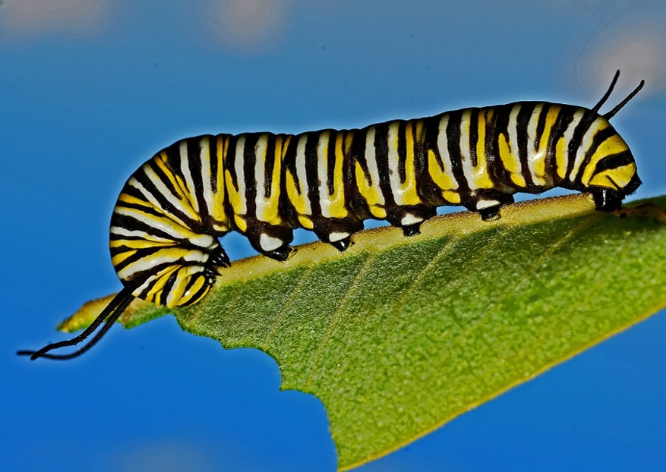


For parents
Thank you for supporting your child’s learning in science.
Before the session:
Please read slide 2 so you know what your child is learning and what you need to get ready.
You may like to print slide 6.
During the session:
Share the learning intentions on slide 2.
Support your child with the activities on slides 3-4, as needed.
Using slides 5-7, help your child conduct an outside survey of a garden habitat (if it is possible for your family).
There are alternative suggestions if you cannot go outside.
Slide 8 has a glossary of key terms.
Reviewing with your child:
Slide 9 gives an idea of what your child may produce.
Living things and their habitats
Local habitats: garden and woodland habitats
Year 4
Age 8-9

Slide 2
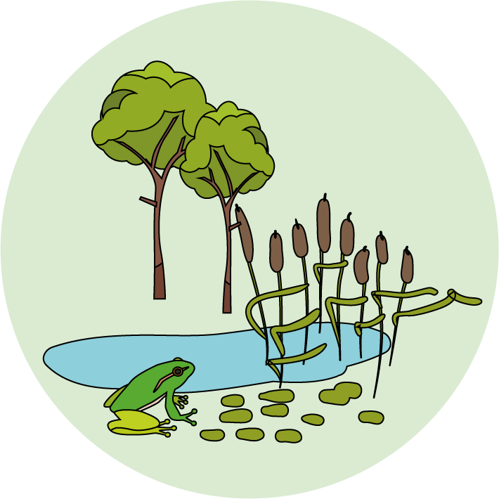

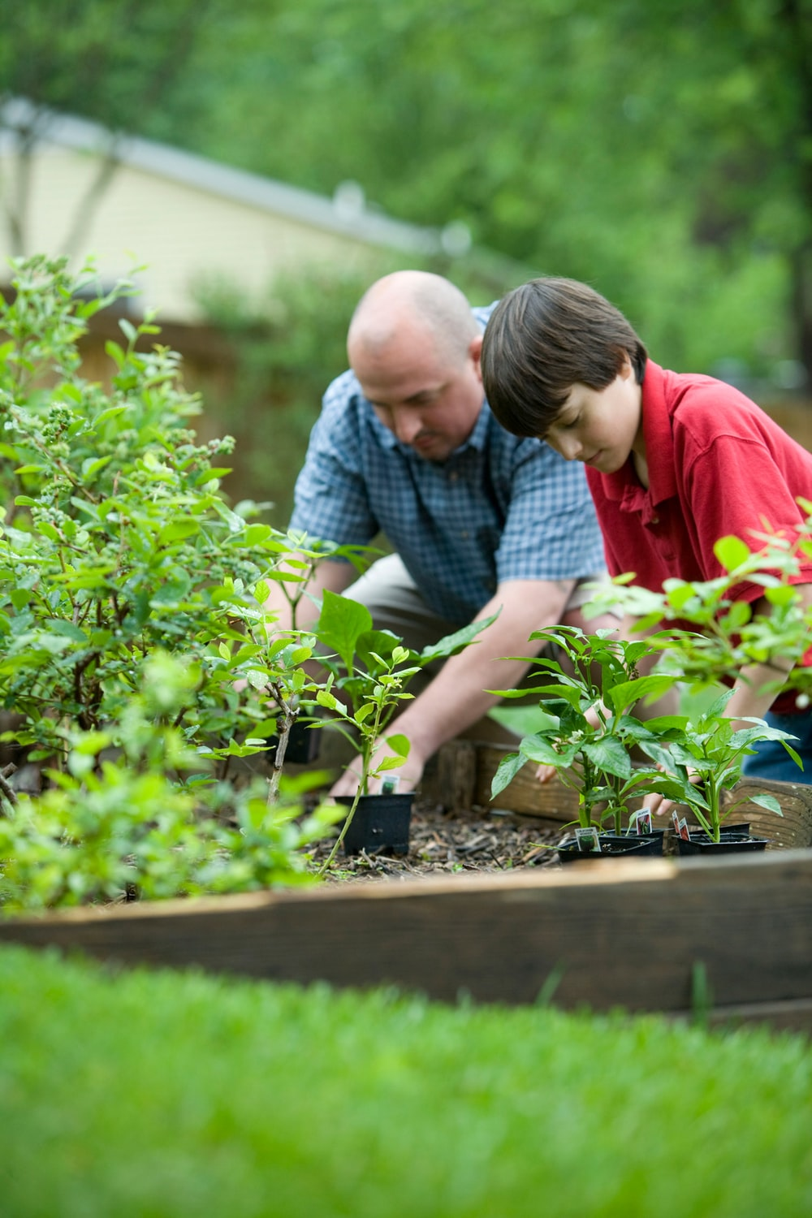
Living things and their habitats
Logo for section to sit inside roundel
Local habitats: woodland and gardens
Key Learning
A habitat provides animals, plants and other living things with food and shelter. A small place where living things can survive is often called a micro-habitat, for example under a log.
Each micro-habitat has different conditions such as the amount of light, the temperature and the amount of moisture.
Activities (pages 3-4): 20 - 30 minutes
Use paper and a pencil for making notes.
Survey of a garden habitat (page 5-7): 30 - 40 minutes
You may wish to print page 6.
There are alternative suggestions if you cannot go outside.
I can…
Describe the conditions in some micro-habitats.
Identify some of the living things found in a garden or woodland habitat.
2

Slide 3
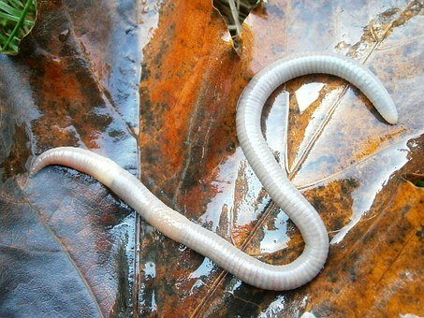
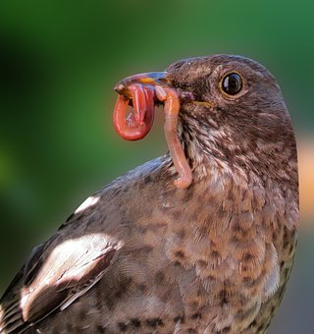
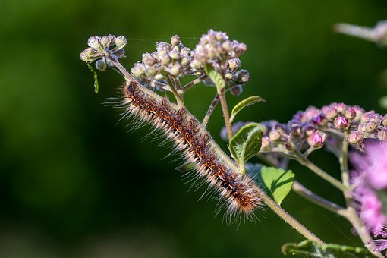
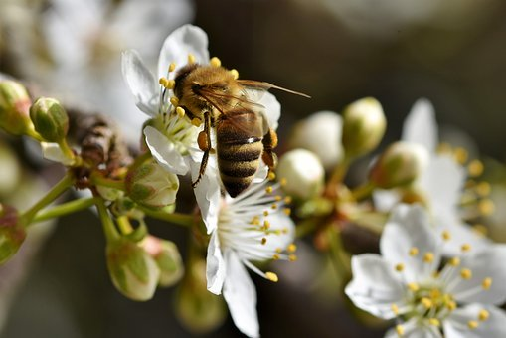
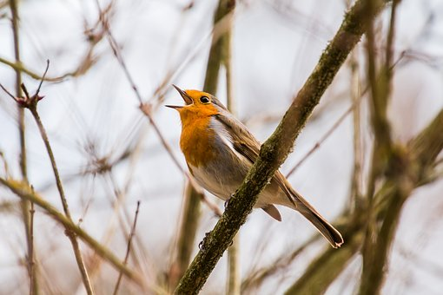
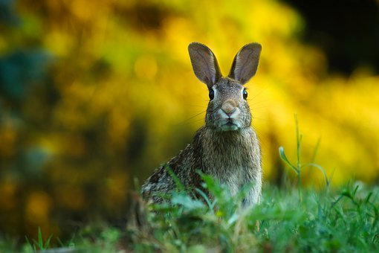
Explore, review, think, talk….
Logo for section to sit inside roundel
What do you already know about woodland or garden habitats?
(10 minutes)
Think or talk about a garden, park or woodland near your home.
What kind of animals, plants and other living things do you know that live there?
Watch this clip about earthworms. https://www.nhm.ac.uk/discover/earthworm-heroes.html
Think or talk about two reasons why earthworms are important in a garden or wood.
Now watch this clip to find out how other living things help to break down leaves.
https://www.bbc.co.uk/teach/class-clips-video/science-ks1-ks2-fallen-leaves-fungi-slime-molds/z7cb47h
3

Slide 4
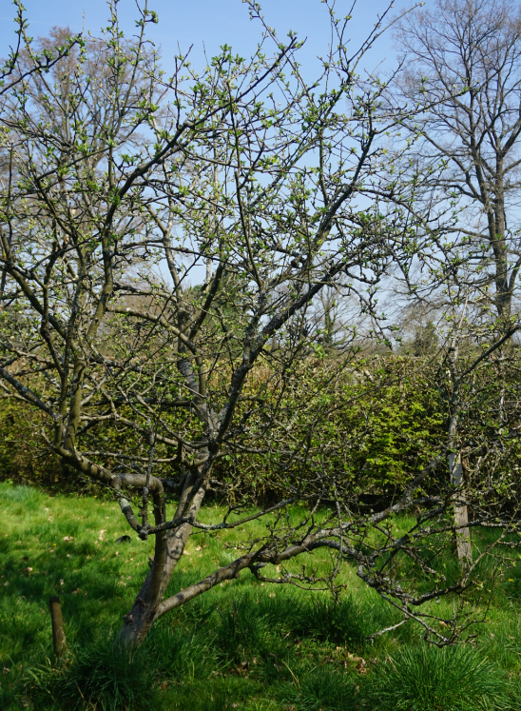
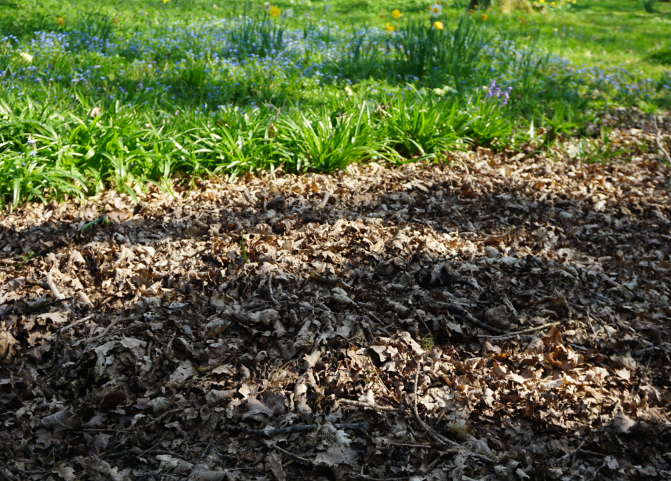
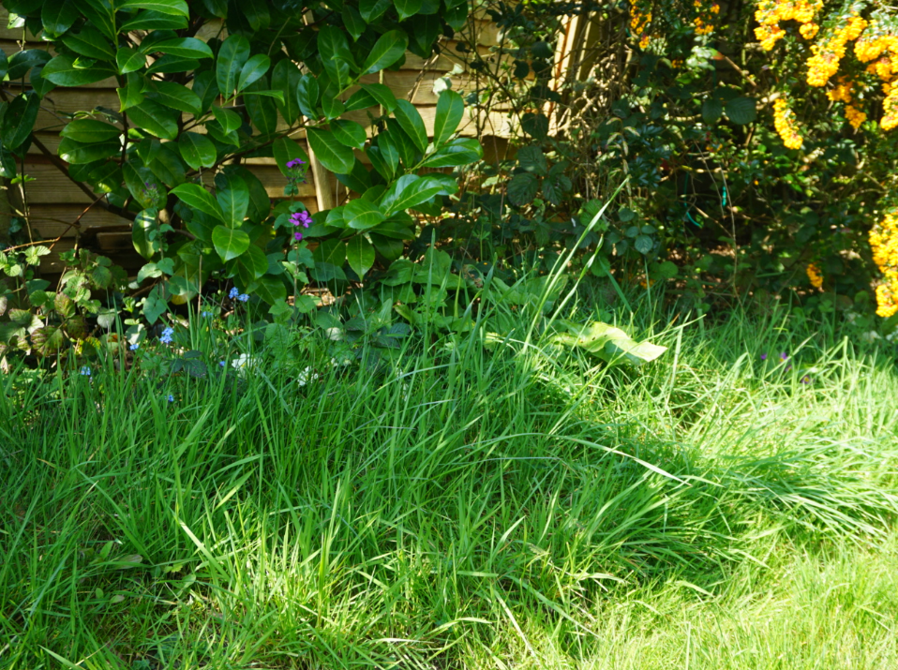
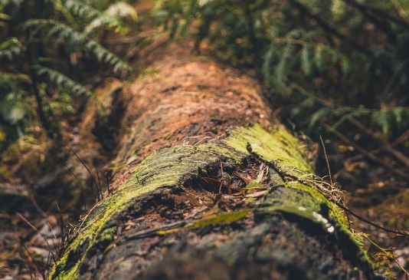
Micro-habitats
Logo for section to sit inside roundel
What kind of micro-habitats are found in woodland or gardens?
(10 minutes)
There are a huge variety of animals, plants and fungi in woods and gardens.
Some animals live, feed and move around in the habitat, such as birds and rabbits.
Other animals live all their time in a small place or micro-habitat.
What kind of animals do you think you might find in these micro-habitats?
What kind of animals might move around to feed in a whole garden habitat?
Jot down your ideas.
Watch these clips for clues.
https://www.bbc.co.uk/programmes/p003lc9k
https://www.bbc.co.uk/programmes/p003kmh2
Pile of leaf litter
Patch of long grass
Tree
For example, a rotting log provides shelter for centipedes and woodlice and there may be decaying leaves for them to eat.
4

Slide 5
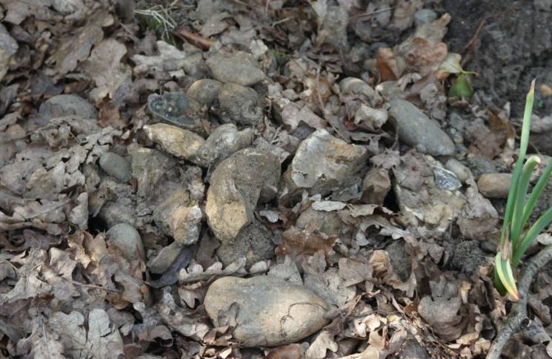
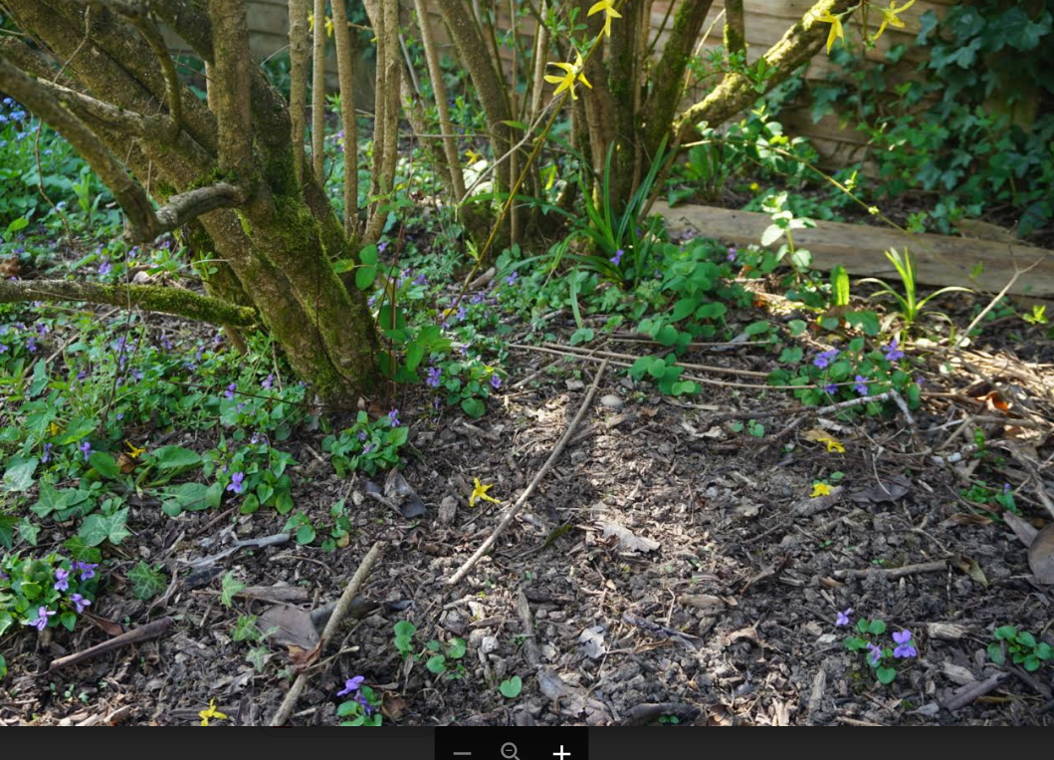
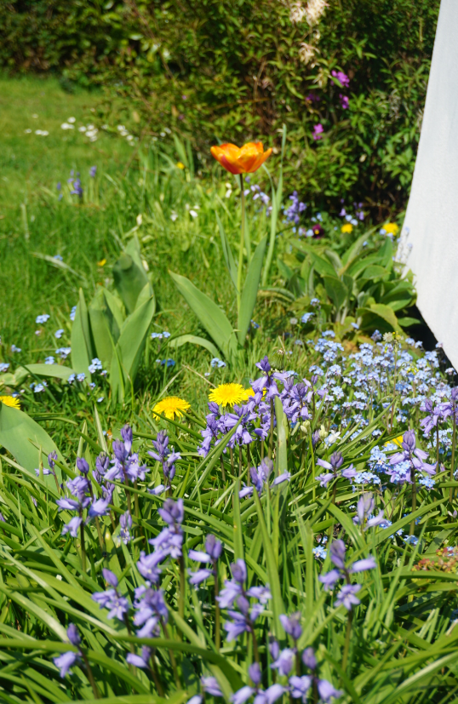
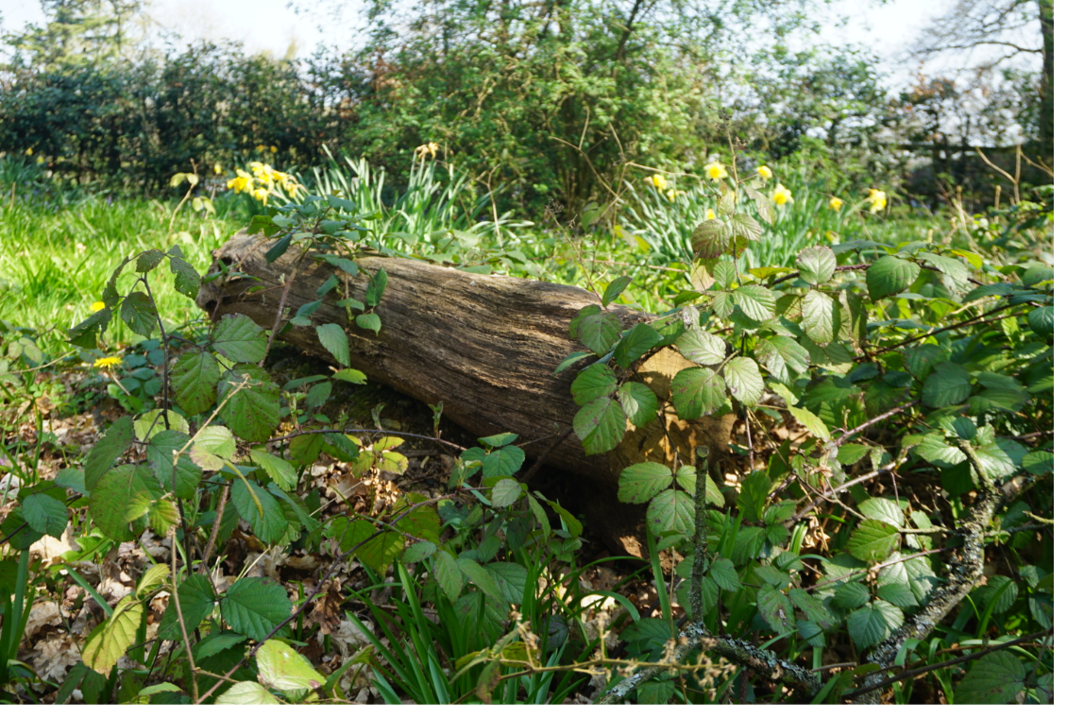
Garden and woodland habitats
Logo for section to sit inside roundel
Observing a habitat and micro-habitats by conducting a survey
(Page 4-6: 40 minutes)
If you have access to a garden, conduct a survey of the habitat. You can also find animals or plants in micro-habitats by looking under logs, stones, bushes or loose soil.
Use the identification key on page 6 to help you.
Make a note of where you find each type of animal.
Ask an adult to help you plan and conduct your habitat and micro-habitat survey.
Follow government guidelines on social distancing and staying safe.
Take care with the plants and animals you find. Avoid touching them, especially those which might bite or sting.
Remember to leave the plants and animals in their habitat.
If you are unable to go outside, you can find out more about woodland habitats here:
https://www.woodlandtrust.org.uk/trees-woods-and-wildlife/habitats/
4

Slide 6
Conducting a survey of a garden habitat and micro-habitats.
Ask an adult to help you plan and conduct the survey. Follow government guidelines on social distancing and staying safe.
Take care with the animals you find. Avoid touching them, especially those which might bite or sting. Leave the animals in their habitat.
Name of animal or plant | Habitat or micro-habitat
6

Slide 7
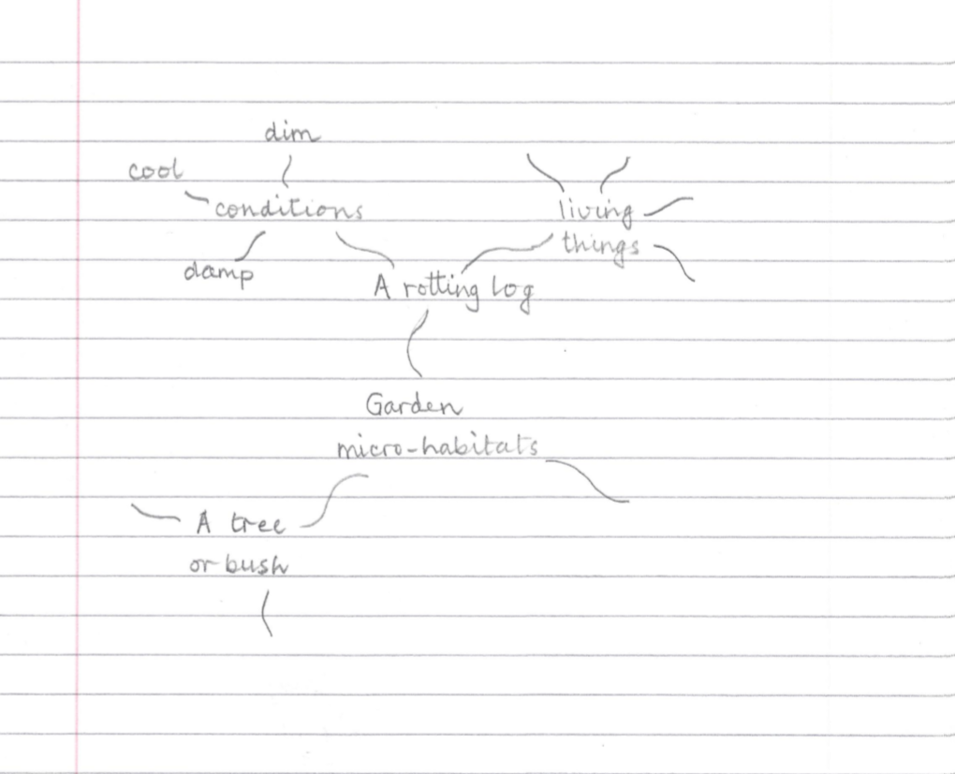
Make a mind map or poster of two or three different micro-habitats you found.
Describe the conditions in each micro-habitat.
  Dry, damp or wet?
  Light, dim or dark?
  Warm or cool?
Add the names of some living things you found.
If you are unable to go outside, use this link to make a poster about a rotting log micro-habitat:
https://www.dkfindout.com/uk/animals-and-nature/habitats-and-ecosystems/rotting-log/
I can describe the conditions in some micro-habitats. I can name some living things in a garden or woodland habitat.
7

Slide 8
Glossary of terms
Environment: The environment includes all living and non-living things. Animals and plants rely on the living and non-living parts of the environment to survive.
Habitat: Living things live in a habitat which provides an environment to which they are suited. A habitat provides living things with food and shelter.
Condition: Each habitat has different conditions such as the amount of light, the temperature and the amount of moisture.
Micro-habitat: A micro-habitat is a small-scale habitat where certain animals or plants can survive. It is usually different from the wider environment.
Identification key: An identification key is a useful tool for identifying unknown living things.
Survey: Scientific surveys are a common method used to collect data about living things.
8

Slide 9
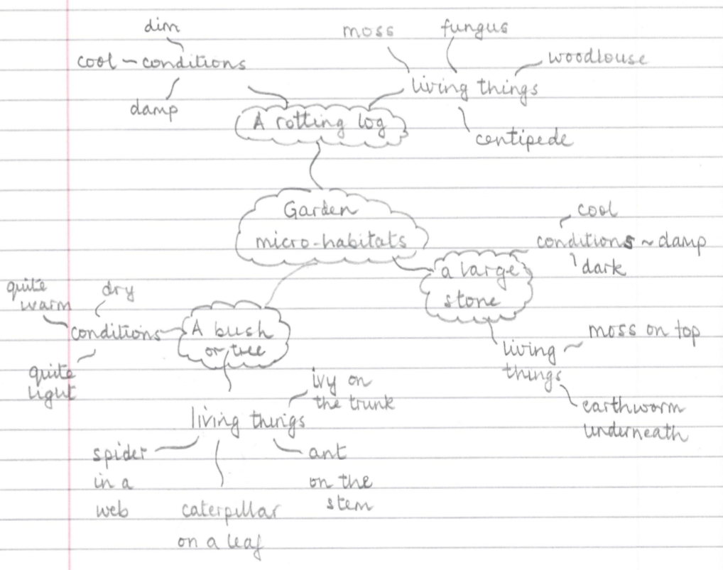
Possible learning outcome for reviewing your work.
I can describe the conditions in some micro-habitats. I can name some living things in a garden or woodland habitat.
Amphibians include frogs, toads and newts. They have a smooth moist skin and are cold blooded. They lay soft jelly-like eggs and can live on land and in the water.
A tree or bush can be a habitat for many living things.
Fungi, moss or ivy can be growing on the trunk of a tree.
Spiders often make webs in the branches.
In the spring and summer months, caterpillars can be found eating the leaves.
Ants can sometimes be seen running along the stems.
A rotting log can provide food and shelter for woodland mushrooms and other fungi as well as small animals like woodlice and centipedes. The conditions are usually damp and cool.
Stones sometimes have moss growing on top.
It is dark underneath the stone and earthworms often lurk there.
9

